Slide 1
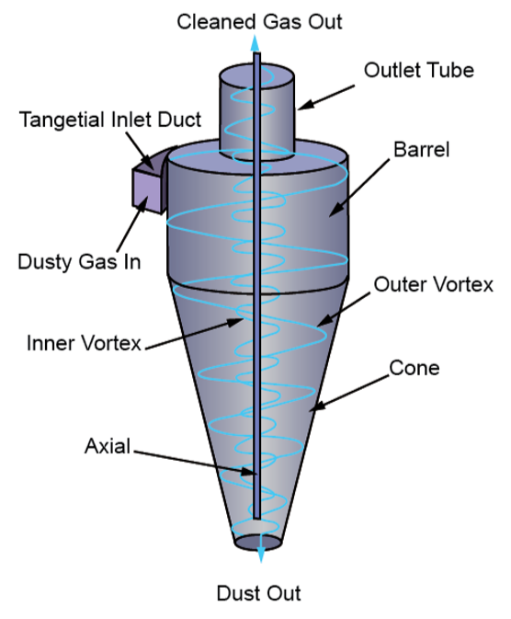
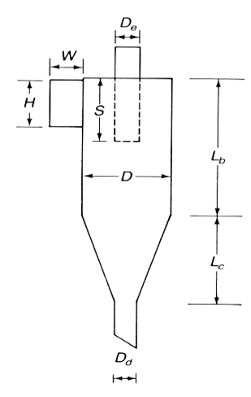

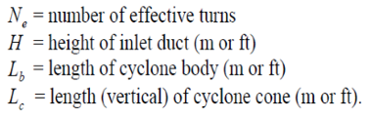
Gas-Solid separation using Cyclone Separator

Slide 2
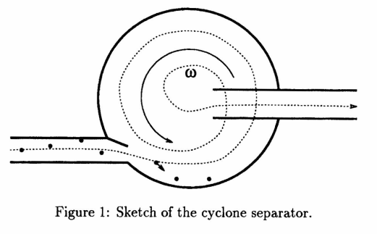

Drift Velocity of Particle

Slide 3
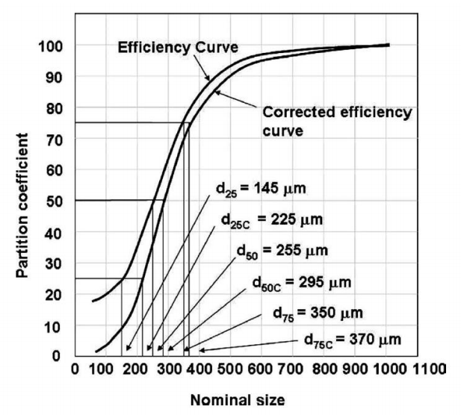
Fractional and Overall efficiency of collection
η_{i}= 1/[1+(d₅₀/d_{pi})²]

Slide 4
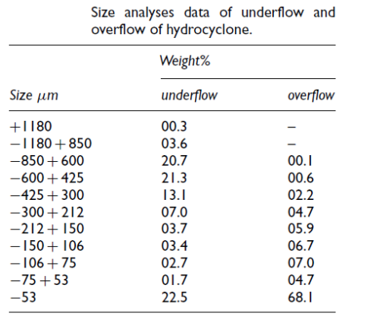
A coal dust is being classified in a cyclone separator by pumping it with air. The percent solids in underflow on dry basis is 38.9%. The size analyses of underflow and overflow solids are given in Table below.

Slide 5
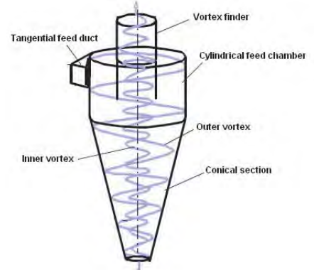
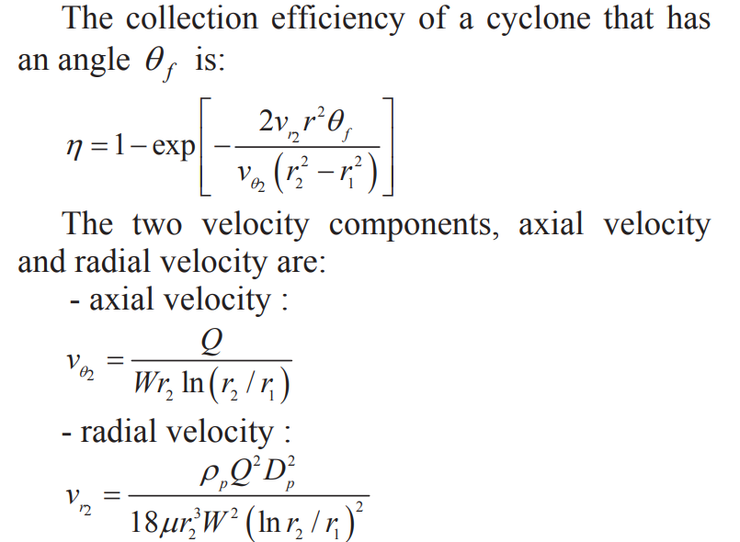
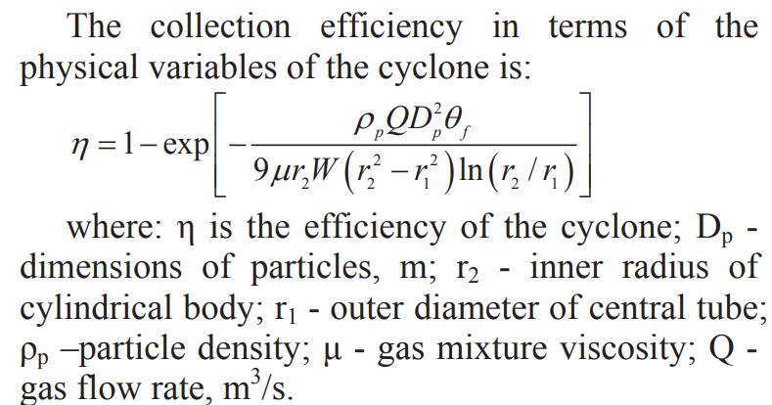
Cyclone efficiency in terms Geometrical parameters

Slide 6
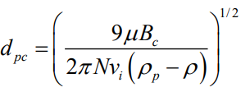
The cut diameter of the cyclone is defined as the size of the particles collected with 50% collection efficiency. It is an indicator of the size range of particles that can be collected.

